Slide 1
UML Implementation Diagrams

Slide 2
Objective
Model the views
Component
Deployment diagram

Slide 3

Models, Views, and Diagrams
A model is a complete
description of a system
from a particular
perspective
Static/structural Views
State
Diagrams
State
Diagrams
Class
Diagrams
Use Case
Diagrams
Use Case
Diagrams
State
Diagrams
Use Case
Diagrams
Use Case
Diagrams
State
Diagrams
Use Case
Diagrams
Object
Diagrams
Sequence
Diagrams
Scenario
Diagrams
State
Diagrams
Scenario
Diagrams
State
Diagrams
Collaboration
Diagrams
Component
Diagrams
Models
Scenario
Diagrams
Component
Diagrams
Scenario
Diagrams
Component
Diagrams
Statechart
Diagrams
Deployment
Diagrams
Activity
Diagrams
Interactions
Dynamic views

Slide 4
Diagrams
In the UML, there are nine standard diagrams
  Static views: use case, class, object, component, deployment
  Dynamic views: sequence, collaboration, state chart, activity

Slide 5
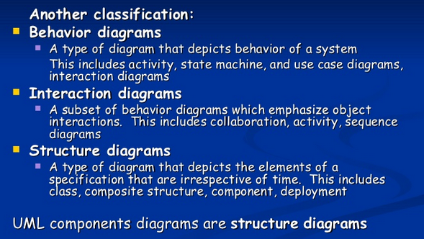
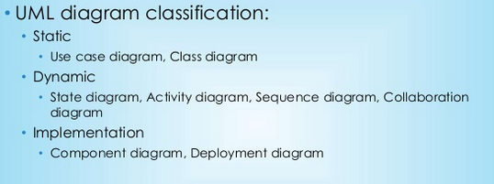
Implementation Diagrams
Both component and deployment to gather are also called as Implementation Diagrams and are under structure diagrams

Slide 6
component diagram vs deployment diagram
Component Diagrams are used to diagram the high level components which you will be developing. For example , in my application, I use COM to separate the modules. Each COM object runs in its own executable and is a modeled as a component.
Deployment Diagrams are used to diagram the actual runtime modules which are required to complete the system. This include your modules and any hardware/software which is required to complete your system. In my application, the Deployment diagram will contain the names of all the servers and which modules they will be running.

Slide 7
Component Diagram

Slide 8
Component Diagrams
Show relationships and dependencies among sets of code without respect to actual physical placement of code
Use only when there is a design issue
General purpose mechanism for organizing elements into groups
Can group classes or components.
Package Name

Slide 9
Uses
Model source code:
  model configuration mgmt
Model executable releases
  Release is relatively complete and consistent set of artifacts delivered to user
  Release focuses on parts necessary to deliver running system
  Component Diagram visualizes, specifies, and documents the decisions about the physical parts that define the software.
Model Physical databases:
  database is concrete realization of schema
  schemas offer an API to persistent information
  model of physical dbases represents storage of that information in tables of a relational dbase or pages of an OO dbase.
  Component Diagram can represent this kind of physical database
Model Adaptable systems:
  can model static aspects of adaptable systems
  can model dynamic aspects (in conjunction with behavioral models)

Slide 10
Component Diagram
Classes
Interfaces
Dependency, generalization, association, and realization relationships
Special kind of class diagram focusing on system’s components.
Example.java
CSE870: UML COMPONENT DIAGRAMS

Slide 11
before drawing a component diagram the following artifacts are to be identified clearly:
Files used in the system.
Libraries and other artifacts relevant to the application.
Relationships among the artifacts.
Now after identifying the artifacts the following points needs to be followed:
Use a meaningful name to identify the component for which the diagram is to be drawn.
Prepare a mental layout before producing using tools.
Use notes for clarifying important points.

Slide 12

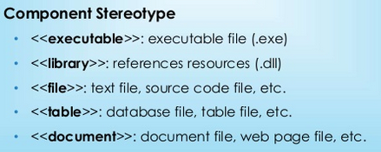
Elements
Component/Node

Slide 13
Common Stereotypes
Stereotype Indicates
<<application>> A “front-end” of your system, such as the collection of HTML pages and ASP/JSPs that work with them for a browser-based system or the collection of screens and controller classes for a GUI-based system.
<<database>> A hierarchical, relational, object-relational, network, or object-oriented database.
<<document>> A document. A UML standard stereotype.
<<executable>> A software component that can be executed on a node. A UML standard stereotype.
<<file>> A data file. A UML standard stereotype.
<<infrastructure>> A technical component within your system such as a persistence service or an audit logger.
<<library>> An object or function library. A UML standard stereotype.
<<source code>> A source code file, such as a .java file or a .cpp file.
<<table>> A data table within a database. A UML standard stereotype
<<web service>> One or more web services.
<<XML DTD>> An XML DTD.
CSE870: UML COMPONENT DIAGRAMS

Slide 14
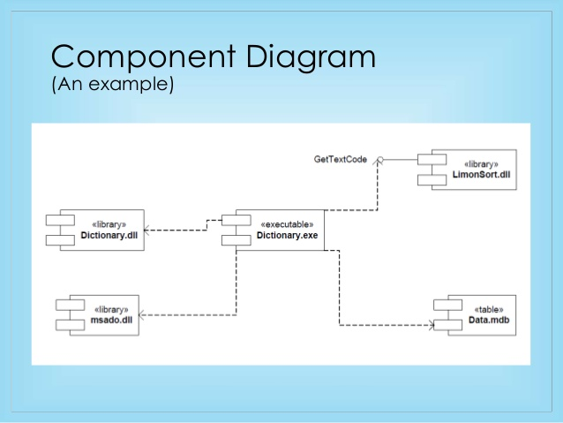
example

Slide 15
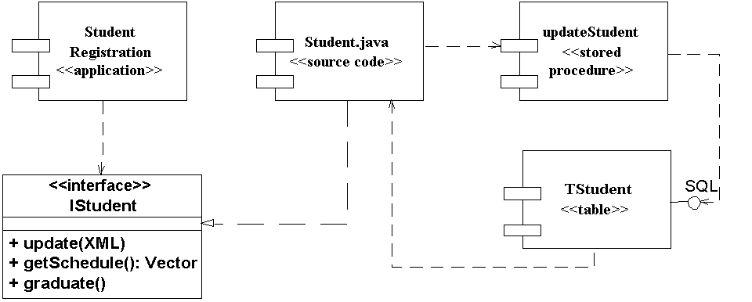
Example

Slide 16
Deployment Diagrams

Slide 17
Deployment Diagrams
Called “environment” diagram
Shows actual physical organization of computation units and connectors
Appropriate to do at this stage--when user requirements are fairly well articulated
May surface practical problems
Should use for “what if’s” (volume, network failures, etc.)
used by system engineers, these diagrams are used to describe the physical components (hardwares), their distribution and association.

Slide 18
The purpose of deployment diagrams can be described as:
Visualize hardware topology of a system.
Describe the hardware components used to deploy software components.
Describe runtime processing nodes.
For this, following artifacts should be identified:
Nodes
Relationships among nodes

Slide 19
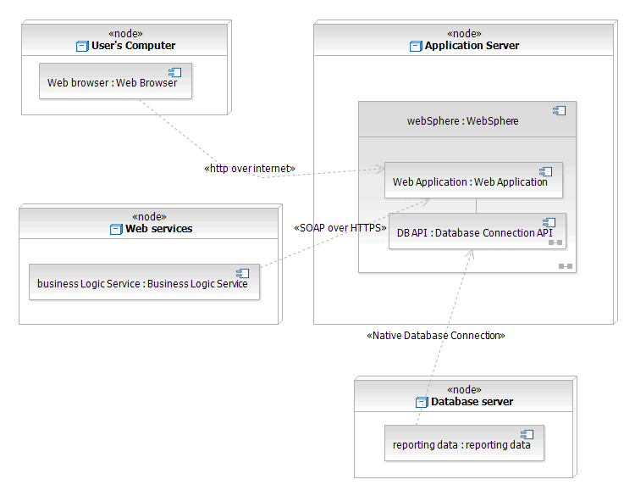
Deployment diagram of a web service

Slide 20
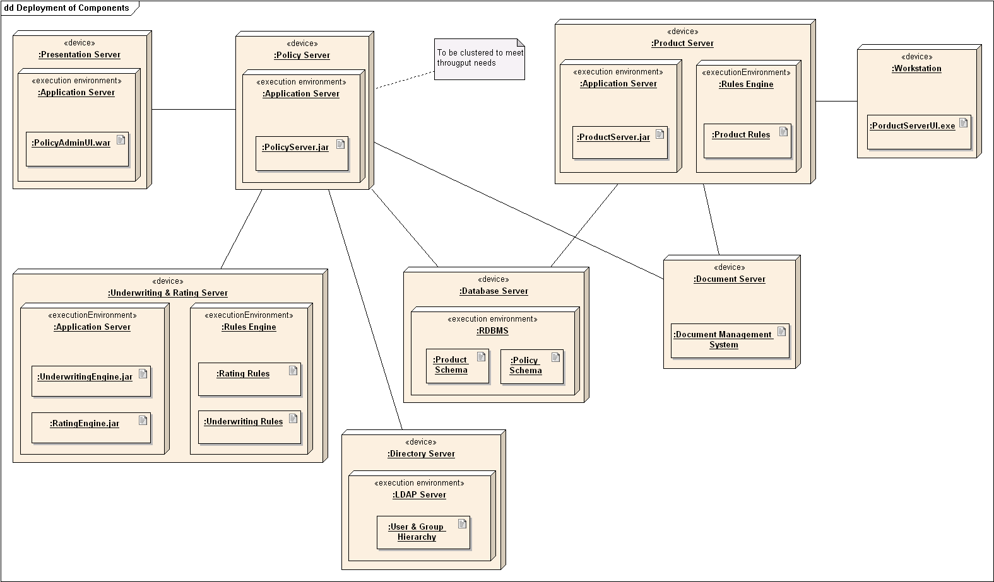
Example -

Slide 21
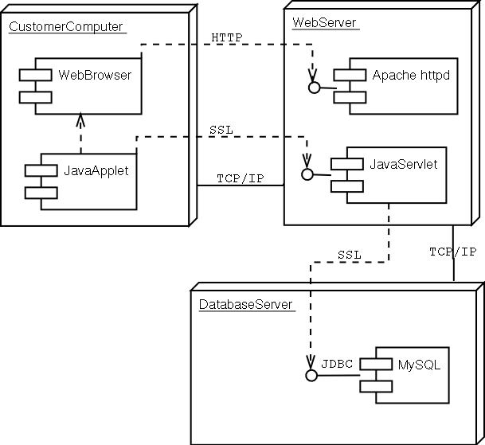
Deployment Diagram

Slide 22
Deployment diagrams
  Show the physical relationship between hardware and software in a system
  Hardware elements:
    Computers (clients, servers)
    Embedded processors
    Devices (sensors, peripherals)
  Are used to show the nodes where software components reside in the run-time system

Slide 23
A Deployment Diagram
Internet
node
Modem bank
<<processor>>
<<processor>>
connection
Caching server
Caching server
<<network>> local network
<<processor>>
<<processor>>
<<processor>>
<<processor>>
primary server
server
server
server
CSE870: UML COMPONENT DIAGRAMS
Notes:
CSE870:Advanced Software Engineering (Cheng)
A node, depicted as a three-dimensional box, represents a computational unit, typically a single piece of hardware, such as a computer, network router, mainframe, sensor, or personal digital assistant (PDA). Components, depicted as rectangles with two smaller rectangles jutting out from the left-hand side (the same notation used on UML Component diagrams), represent software artifacts such as file, framework, or domain component.

